Slide 1
IPL Cricket Analysis
Problem Statement
"Sports Basics" is a sports blog company that entered space recently. They wanted to get more traffic to their website by releasing a special edition magazine on IPL 2024. This magazine aims to provide interesting insights and facts for fans, analysts and teams based on the last 3 years' data.
The chief editor Tony Sharma oversees this publication, and he believes in data analytics. He reached out to Peter Pandey, a journalist in his team who is a data savvy cricket enthusiast.
Task:
Imagine yourself as Peter Pandey and perform the following task.
Begin your analysis by referring to the ‘Primary And Secondary Analysis’. You can use any tool of your choice (Python, SQL, Power BI, Tableau, Excel, PowerPoint) to analyse and answer these questions

Slide 2
IPL Cricket Analysis
Primary Analysis
Secondary Analysis
Top 10 batsmen based on past 3 years total runs scored. (min 60 balls faced in each season).
Top 10 batsmen based on past 3 years batting average. (min 60 balls faced in each season).
Top 10 batsmen based on past 3 years strike rate (min 60 balls faced in each season).
Top 5 batsmen based on past 3 years boundary % (fours and sixes).
Top 10 bowlers based on past 3 years total wickets taken.
Top 10 bowlers based on past 3 years bowling average. (min 60 balls bowled in each season).
Top 10 bowlers based on past 3 years economy rate. (min 60 balls bowled in each season).
Top 5 bowlers based on past 3 years dot ball %.
Top 4 teams based on past 3 years winning %.
Top 2 teams with the highest number of wins achieved by chasing targets over the past 3 years.
Predict the following for the season 2024 using available data and by doing additional research,
Orange and purple cap player.
Top 4 qualifying teams.
Winner and runner-up
Your Picks :
Pick your team selecting the Best 11 players based on their positions, 3 years performance data and additional research.
Pick your top 3 all-rounders

Slide 3
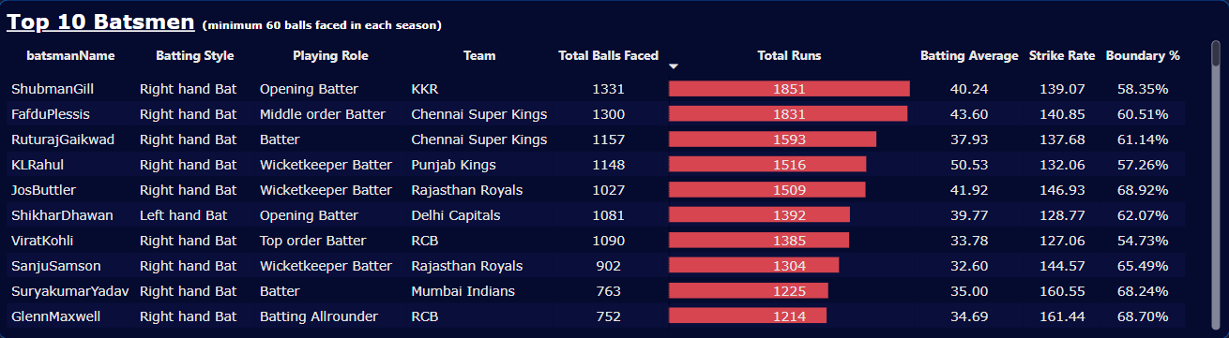
IPL Cricket Analysis
Primary Analysis
1. Top 10 batsmen based on past 3 years total runs scored. (min 60 balls faced in each season)

Slide 4
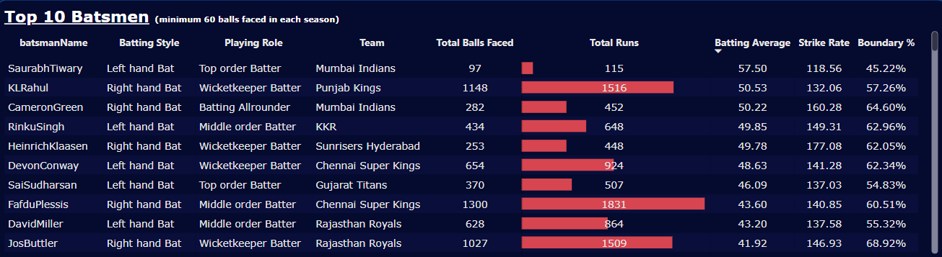
IPL Cricket Analysis
2. Top 10 batsmen based on past 3 years batting average. (min 60 balls faced in each season)

Slide 5
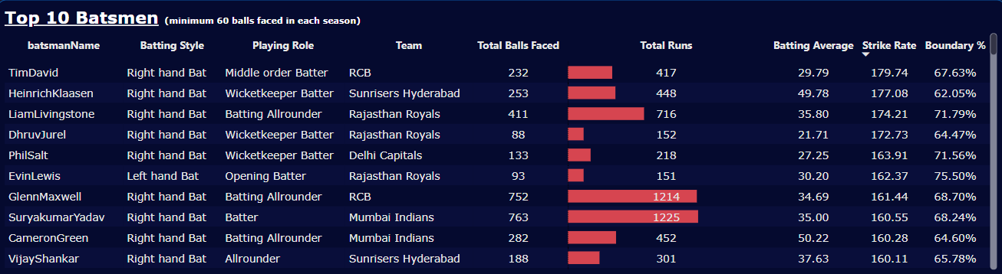
IPL Cricket Analysis
3. Top 10 batsmen based on past 3 years strike rate (min 60 balls faced in each season)

Slide 6
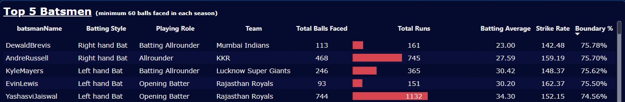
IPL Cricket Analysis
4. Top 5 batsmen based on past 3 years boundary % (fours and sixes).

Slide 7
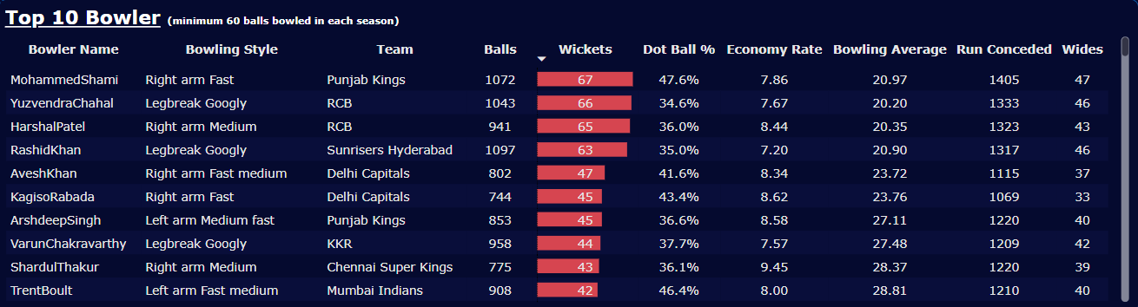
IPL Cricket Analysis
5. Top 10 bowlers based on past 3 years total wickets taken.

Slide 8
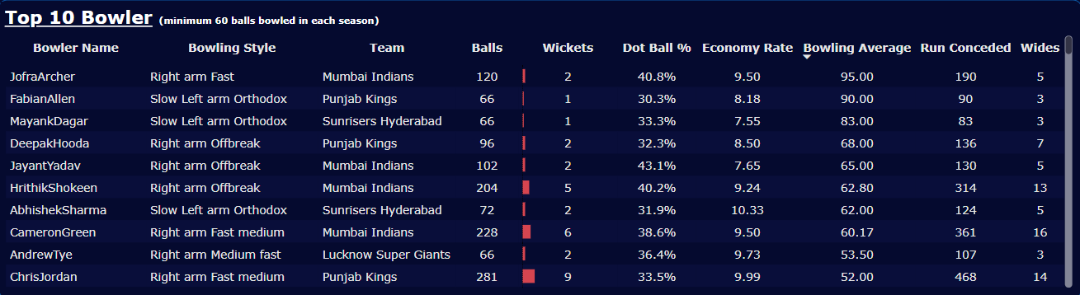
IPL Cricket Analysis
6. Top 10 bowlers based on past 3 years bowling average. (min 60 balls bowled in each season)

Slide 9
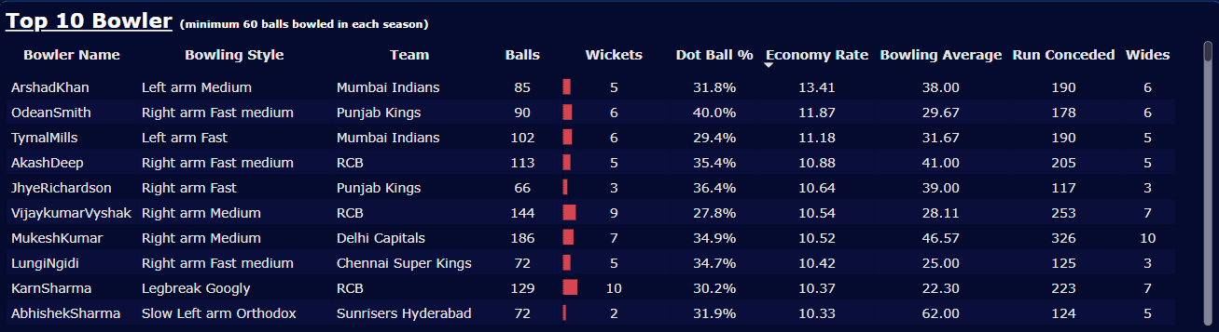
IPL Cricket Analysis
7. Top 10 bowlers based on past 3 years economy rate. (min 60 balls bowled in each season)

Slide 10
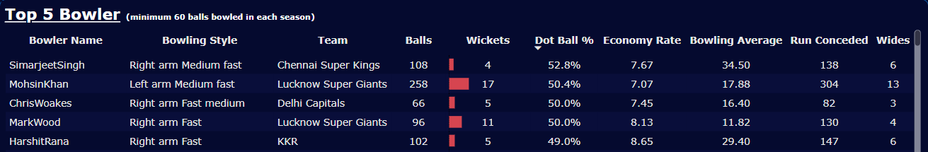
IPL Cricket Analysis
8. Top 5 bowlers based on past 3 years dot ball %.

Slide 11
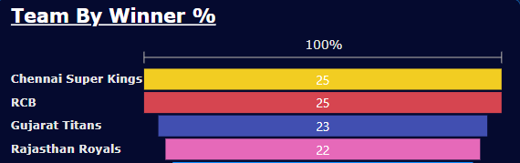
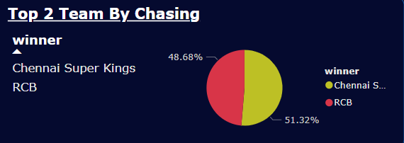
IPL Cricket Analysis
9. Top 4 teams based on past 3 years winning %.
10. Top 2 teams with the highest number of wins achieved by chasing targets over the past 3 years.

Slide 12
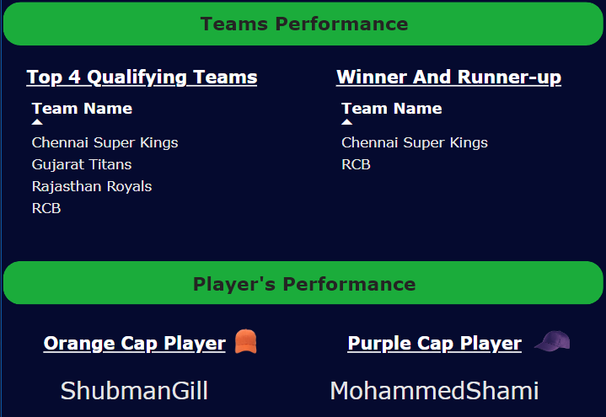
IPL Cricket Analysis
Secondary Analysis
Top 4 qualifying teams.
Winner and runner-up
3. Orange and purple cap player.

Slide 13
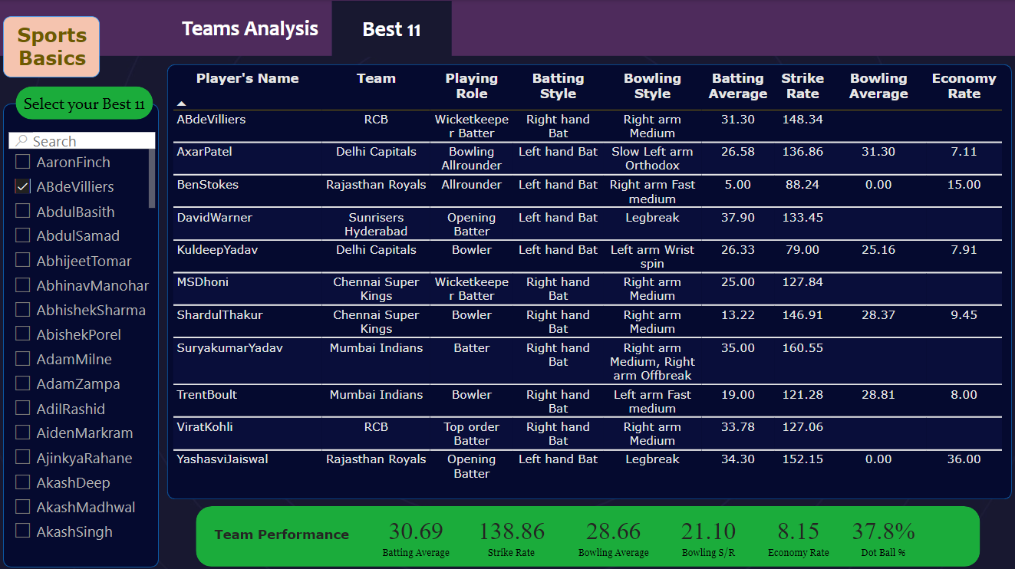
IPL Cricket Analysis
4. Pick your team selecting the Best 11 players based on their positions, 3 years performance data and additional research

Slide 14
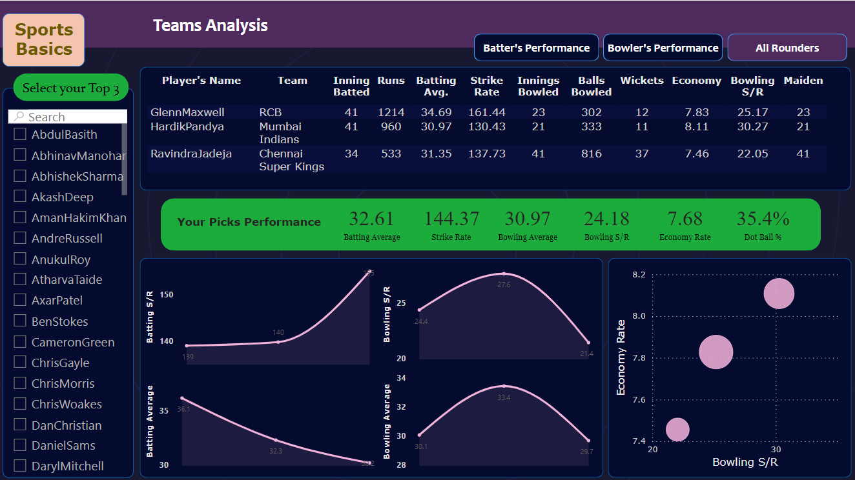
IPL Cricket Analysis
5. Pick your top 3 all-rounders.

Slide 15
IPL Cricket Analysis
* Thank You *

